Slide 1
DECK 3b – basic statistical applications
Dr. Jack Hong
Adjunct Faculty, Lee Kong Chian School of Business, SMU
Co-founder, Research Room Pte. Ltd.

Slide 2
Before we start…
What’s the difference between statistical and machine learning models?
They are more similar than most people realize
Both models attempt to extract patterns from data that estimates relationships between variables
Statistics focus on describing the data and validating hypotheses about the data (inference)
Inference: Draw conclusions about a set of information, guided by what the researcher knows/hypothesizes
Usually backed by theories, even if model is stylized
Exploratory: Discover new features
Confirmatory: Prove hypotheses to be True or False
Machine learning focus on extracting patterns (mining) from data and using it for prediction
Data mining starts from “I have no idea what I’m looking for”
Finding patterns and anomalies to form insights
Statistical models that extract patterns from data are found in machine learning as well (e.g. regressions)

Slide 3
Estimating relationships

Slide 4
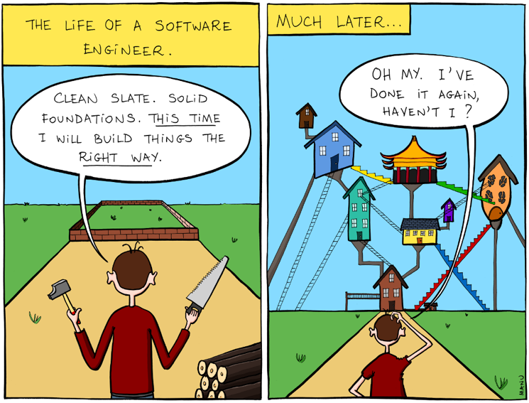
Before you start playing with the data: visualize the layout!

Slide 5
What kind of Variables are there?
Variable (Random Variable)
A characteristic that takes different values for different entities (e.g. person, stock)
2 types:
Quantitative
Categorical
Often used for qualitative data
Person | Date | Gender | AgeRange | Citizenship | MaritalStatus
S1234567A | 2014-10-31 20:41:49 | Male | 11 | 2 | 2
S1234568B | 2014-11-01 10:40:33 | Female | 3 | 2 | 1
Variable | Quantitative | Categorical
Age | Year-month-day-hour-min-secs | Gen X; Gen Y; Millennials
Salary | $ and cents | Grade A, B, C Supergrade

Slide 6
Categorical variables
3 subtypes of Categorical Variables
Nominal: Unordered
Dummy: Takes only 2 values (1 or 0), typically used to represent (Yes, No) or (Success, Failure)
Ordinal: Ordered but no defined distance between intervals
The first 2 subtypes are the most common
Variable | Quantitative | Categorical
 |  | Nominal | Ordinal | Dummy
Education | No. of Years | Law; Finance; Physics; Psychology; Business; Economics | PSLE; O-Levels; A-Levels; Diploma; Undergrad; Postgrad | Have Bachelor Degree?
Notes: | Can rank in terms of duration. Difference between ranks are uniform. | Unable to rank. | Can rank in terms of academic potential, but the difference between ranks are not uniform. | Yes, No

Slide 7
Quantitative variables
2 subtypes of Quantitative Variables
Distance of intervals are uniform
The effect of an increment from 2 to 3 is of the same magnitude as an increment from 3 to 4
Discrete: Integers (e.g. 0, 1, 2, 3, 4)
Continuous: Infinite possibilities within a range (i.e. floating numbers like 3.14159265359 where the number of decimals can go to infinity)
Both discrete and continuous variables are treated in the same manner in statistical work

Slide 8
important note about variables
Model designs and interpretations are distinctive between
quantitative and categorical variables
nominal and ordinal variables
Example: Salary increases with Age (quantitative, ordinal)
As age increases, we tend to see salary increasing as well
Example: Salary increment in 2018 is positive with Race A, B, and negative with Race C (categorical, nominal)
Races do not have an ordinal scale (e.g. There is no logic why Race A is greater or smaller than C)
Categorical
Levels
Quantitative
Number line
Dummy
1 or 0
Nominal
Unordered
Ordinal
Unequal intervals
Discrete
Integers
Continuous
Floating point
Variables
Values

Slide 9
Data setup
Cross-sectional
Each observation is an entity (individual, firm etc) with associated information at a specific point in time
Various characteristics that are observed in conjunction with the observation are known as features
Data analytics is generally about associating characteristics with an outcome (e.g. Earnings before interests and taxes - EBIT), then using the strength or probability of the association to predict future EBIT given a set of features
Example: Given the strength of the associations of the characteristics of a company and its EBIT in 2010, we can predict 2011 EBIT using the characteristics observed in 2011.
Features
Company Name | Exchange:Ticker | Excel Company ID | Year | Total Revenue | Gross Profit | EBITDA | EBIT
3Cnergy Limited (Catalist:502) | Catalist:502 | IQ79611391 | 2006 | 50.2 | 12.6 | 4.76 | 3.56
3SBio Inc. (SEHK:1530) | SEHK:1530 | IQ24164591 | 2006 | 64.5 | 14 | 11.7 | 11.4
800 Super Holdings Limited (Catalist:5TG) | Catalist:5TG | IQ137292017 | 2006 | 19.1 | 3.45 | 4.24 | 2.22
Observations

Slide 10
Data setup
Time Series
Dataset consist of 1 entity, tracked over time
Sample is not random, need to consider corrections on many fronts
Important for trending and seasonality studies
Important for within-person studies, where data is collected on a person over time (“The best predictor of future behavior is past behavior.”)
Note: Features that does not vary between observations (such as Exchange:Ticker and Excel Company ID in the following table) are not useful for algorithms
Features
Company Name | Exchange:Ticker | Excel Company ID | Year | Total Revenue | Gross Profit | EBITDA | EBIT
3Cnergy Limited (Catalist:502) | Catalist:502 | IQ79611391 | 2006 | 50.2 | 12.6 | 4.76 | 3.56
3Cnergy Limited (Catalist:502) | Catalist:502 | IQ79611391 | 2007 | 44.7 | 13.3 | 5.62 | 4.61
3Cnergy Limited (Catalist:502) | Catalist:502 | IQ79611391 | 2008 | 57.9 | 16.8 | 5.39 | 3.75
3Cnergy Limited (Catalist:502) | Catalist:502 | IQ79611391 | 2009 | 114.1 | 39 | 23.9 | 22.7
3Cnergy Limited (Catalist:502) | Catalist:502 | IQ79611391 | 2010 | 97.8 | 33.2 | 18.8 | 17.5
3Cnergy Limited (Catalist:502) | Catalist:502 | IQ79611391 | 2011 | 92.3 | 20.5 | 5.02 | 3.51
3Cnergy Limited (Catalist:502) | Catalist:502 | IQ79611391 | 2012 | 80.9 | 19 | 6.4 | 5.22
3Cnergy Limited (Catalist:502) | Catalist:502 | IQ79611391 | 2013 | 89.3 | 19.9 | 6.74 | 5.42
3Cnergy Limited (Catalist:502) | Catalist:502 | IQ79611391 | 2014 | 120.2 | 24.6 | 9.38 | 7.73
Observations

Slide 11
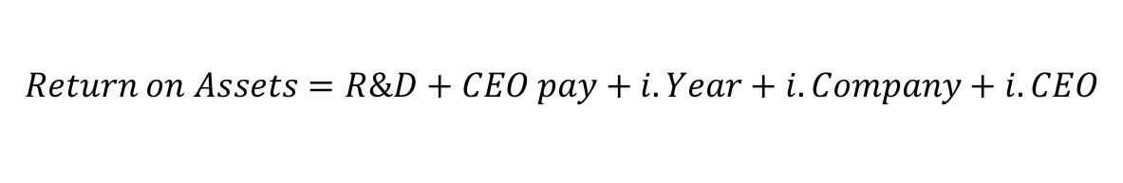
Data setup
Panel data (we encounter such datasets most of the time)
Pooled cross-sectional and time-series data
We treat this similarly to a normal cross-sectional dataset
Accounting for time differences can be easily accomplished using time categorical variables, and can be extended to any subset of groupings
Useful for tracking the same entities over time
Company Name | Exchange:Ticker | Excel Company ID | Year | Total Revenue | Gross Profit | EBITDA | EBIT
3Cnergy Limited (Catalist:502) | Catalist:502 | IQ79611391 | 2006 | 50.2 | 12.6 | 4.76 | 3.56
3Cnergy Limited (Catalist:502) | Catalist:502 | IQ79611391 | 2007 | 44.7 | 13.3 | 5.62 | 4.61
3Cnergy Limited (Catalist:502) | Catalist:502 | IQ79611391 | 2008 | 57.9 | 16.8 | 5.39 | 3.75
3SBio Inc. (SEHK:1530) | SEHK:1530 | IQ24164591 | 2006 | 64.5 | 14 | 11.7 | 11.4
3SBio Inc. (SEHK:1530) | SEHK:1530 | IQ24164591 | 2007 | 346.9 | 11.4 | -0.287 | -1.42
3SBio Inc. (SEHK:1530) | SEHK:1530 | IQ24164591 | 2008 | 366 | 10.1 | -2.66 | -3.85
800 Super Holdings Limited (Catalist:5TG) | Catalist:5TG | IQ137292017 | 2006 | 19.1 | 3.45 | 4.24 | 2.22
800 Super Holdings Limited (Catalist:5TG) | Catalist:5TG | IQ137292017 | 2007 | 22.2 | 3.06 | 3.61 | 2.1
800 Super Holdings Limited (Catalist:5TG) | Catalist:5TG | IQ137292017 | 2008 | 17.3 | 0.958 | 1.76 | 0.172
$$Return on Assets=R\&D+CEO pay+i.Year+i.Company+i.CEO$$
Dependent Variable
Independent variables
Categorical effects: Year, Company and Person dummies
Notes:
Tackle question 1 here.

Slide 12
In the next section…
We will cover 2 basic but very important statistical models:
Linear regression
Logistic regression
Most studies involving statistical modeling rely on these 2 models
Linear regression estimates the strength of the relation between X and Y
Logistic regression estimates the increased/decreased probability of observing Y when X is present
There are many advanced variants but we will not introduce them in this pre-course
Email me for resources if you are interested to learn more

Slide 13
Statistical model techniques
the linear regression

Slide 14
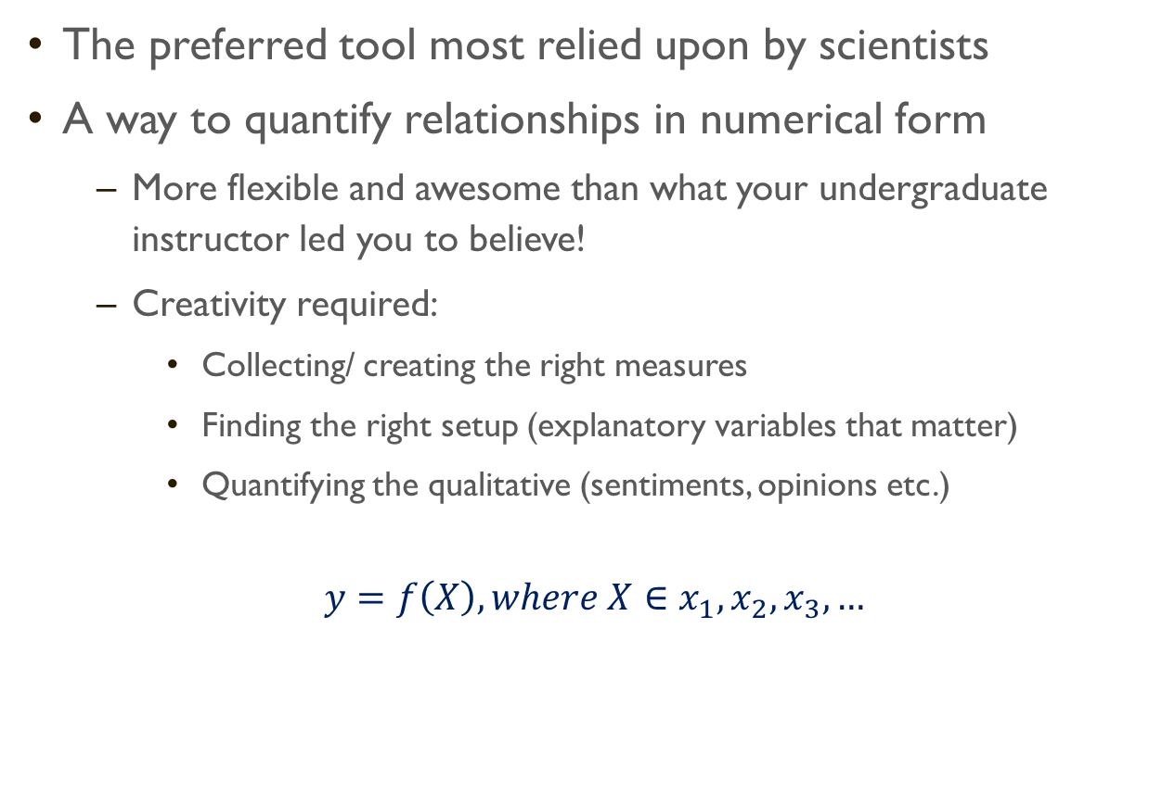
Regression analysis
The preferred tool most relied upon by scientists
A way to quantify relationships in numerical form
More flexible and awesome than what your undergraduate instructor led you to believe!
Creativity required:
Collecting/ creating the right measures
Finding the right setup (explanatory variables that matter)
Quantifying the qualitative (sentiments, opinions etc.)
$$y=f\left(X\right), where X∈x_{1},x_{2},x_{3}, …$$
LHS
Dependent variable
Response variable
Explained variable
Regressand
RHS
Independent variable
Explanatory variable
Regressor
Covariate
Control variable

Slide 15
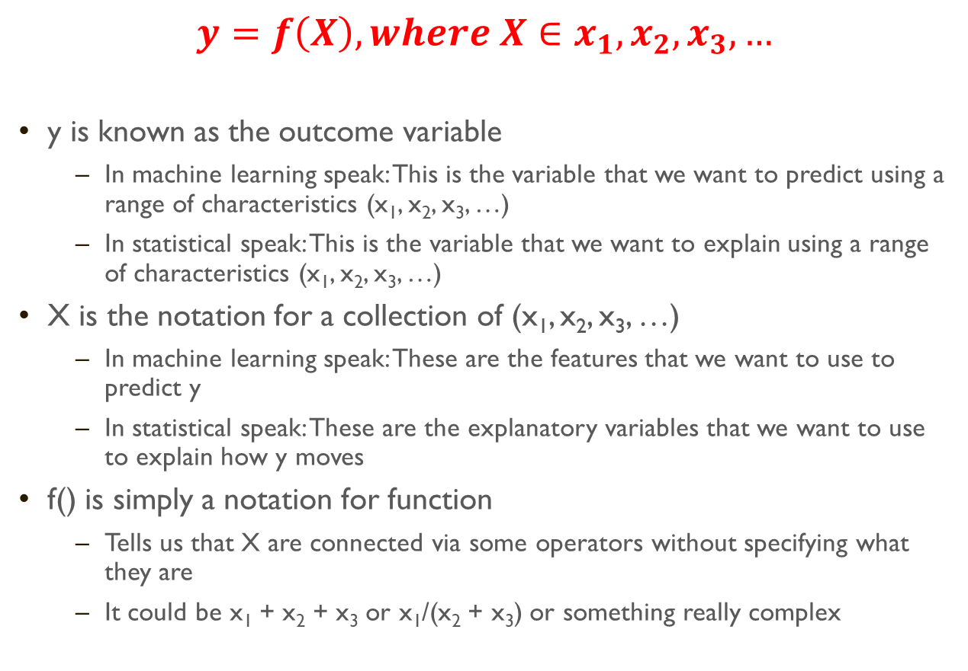
Regression analysis
$$y=f\left(X\right), where X∈x_{1},x_{2},x_{3}, …$$
y is known as the outcome variable
In machine learning speak: This is the variable that we want to predict using a range of characteristics (x₁, x₂, x₃, …)
In statistical speak: This is the variable that we want to explain using a range of characteristics (x₁, x₂, x₃, …)
X is the notation for a collection of (x₁, x₂, x₃, …)
In machine learning speak: These are the features that we want to use to predict y
In statistical speak: These are the explanatory variables that we want to use to explain how y moves
f() is simply a notation for function
Tells us that X are connected via some operators without specifying what they are
It could be x₁ + x₂ + x₃ or x₁/(x₂ + x₃) or something really complex

Slide 16


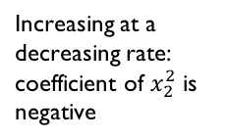

The Linear Regression
If f() is linear, then the equation can be written as a linear combination of X:
$y=x_{1}$+${ x}_{2}$+${ x}_{3}+…$
Linear equations are not as linear as it seems. By creating variables such as squared terms (age x age) or interaction terms (age x qualification), we introduce non-linearity to the regression model
$ln⁡(y)=x_{1}$+${ x}_{2}+x_{2}^{2}+{ x}_{3}+{ x}_{1}{.x}_{3}+…$
$$y$$
Loglinear transformation, interpret as % change in y
x₂-squared, captures 2nd derivative (d²y/dx²) – rate of change
Interaction term, similar to squared terms, captures rate of change between 2 variables
Increasing at a decreasing rate: coefficient of $x_{2}^{2}$ is negative
$${ x}_{2}$$

Slide 17
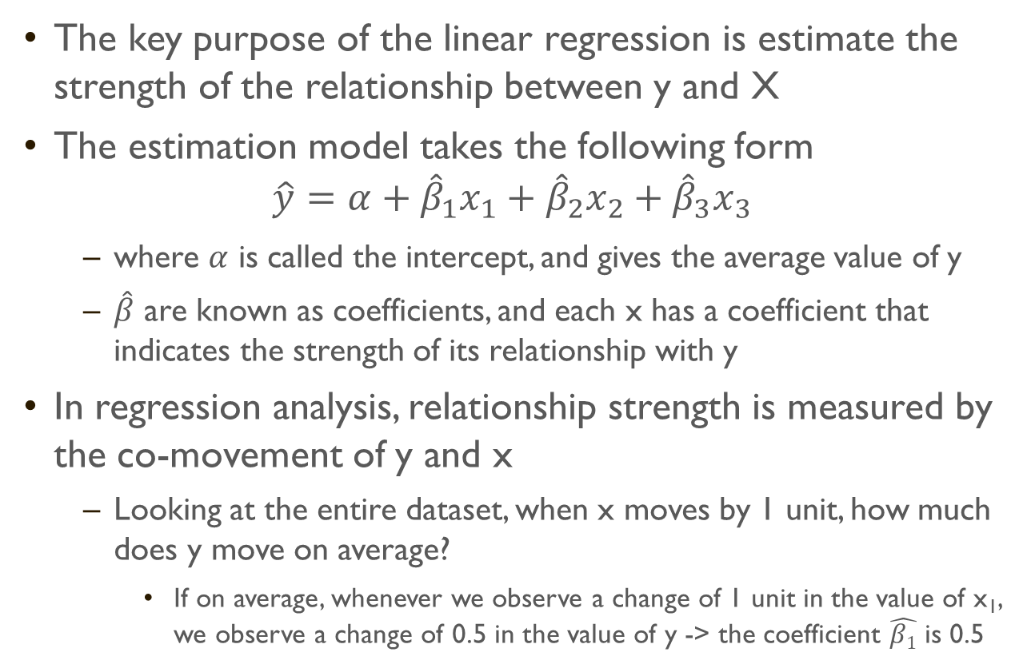
The linear regression
The key purpose of the linear regression is estimate the strength of the relationship between y and X
The estimation model takes the following form
$$\hat{y}=α+{\hat{β}}_{1}x_{1}+{\hat{β}}_{2}x_{2}+{\hat{β}}_{3}x_{3}$$
where $α$ is called the intercept, and gives the average value of y
$\hat{β}$ are known as coefficients, and each x has a coefficient that indicates the strength of its relationship with y
In regression analysis, relationship strength is measured by the co-movement of y and x
Looking at the entire dataset, when x moves by 1 unit, how much does y move on average?
If on average, whenever we observe a change of 1 unit in the value of x₁, we observe a change of 0.5 in the value of y -> the coefficient $\hat{β1}$ is 0.5

Slide 18
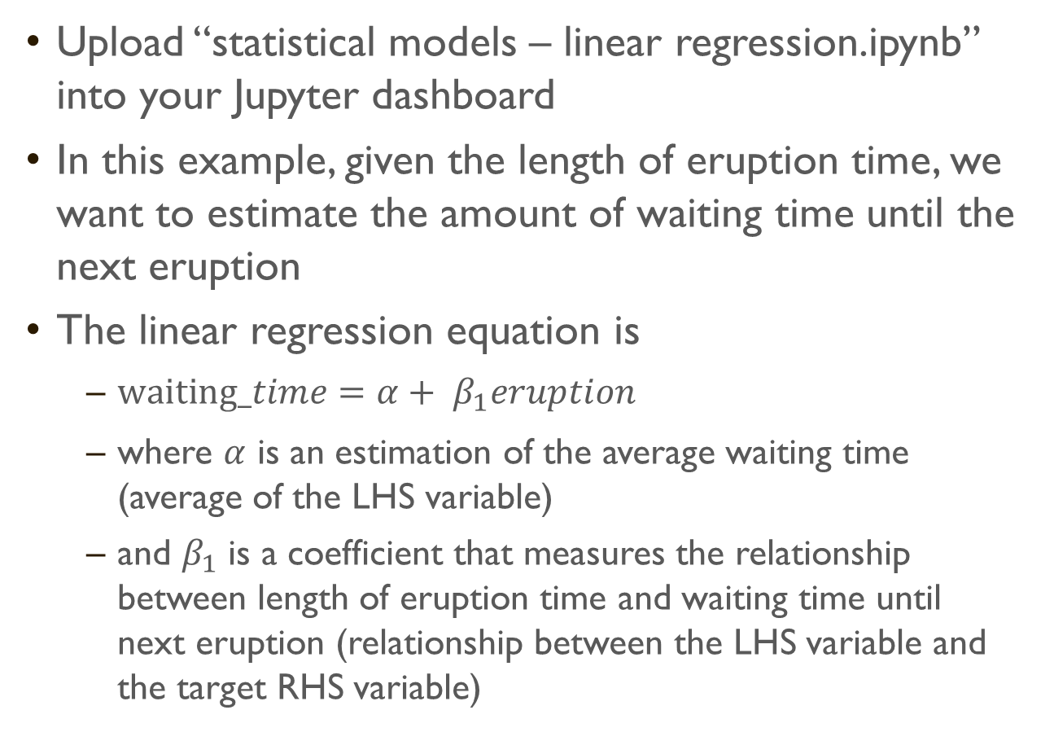
Simple example
Upload “statistical models – linear regression.ipynb” into your Jupyter dashboard
In this example, given the length of eruption time, we want to estimate the amount of waiting time until the next eruption
The linear regression equation is
$waiting_time=α+ β_{1}eruption$
where $α$ is an estimation of the average waiting time (average of the LHS variable)
and $β_{1}$ is a coefficient that measures the relationship between length of eruption time and waiting time until next eruption (relationship between the LHS variable and the target RHS variable)

Slide 19
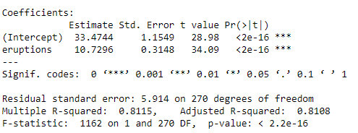
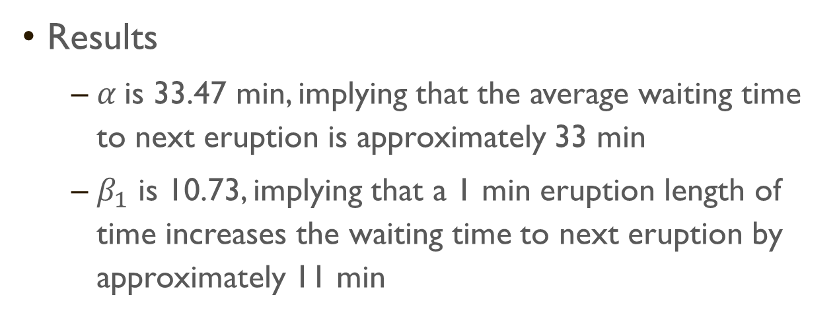
Results output from R
Results
$α$ is 33.47 min, implying that the average waiting time to next eruption is approximately 33 min
$β_{1}$ is 10.73, implying that a 1 min eruption length of time increases the waiting time to next eruption by approximately 11 min

Slide 20
The linear regression (T-Value)
However, knowing the coefficient is not sufficient
In statistics, we have tests to show whether the coefficient is significant or not
This test of significance determines whether the value of the coefficient is statistically different from 0 or not
If the coefficient is 0, this implies that there is no relationship
The test for this significance involves dividing the estimated coefficient by the standard error (the difference between all observed and predicted values)
If the standard error is small, then the coefficient is likely to be different from 0
The divided value is known as the t-value, and the cutoffs are at confidence levels (CI) of 90% (~ t-value above 1.6), 95% (~ t-value above 1.8), and 99% (t-value above ~1.97)
Most statistical packages use *, **, *** to denote 90%, 95%, and 99% CI
In the results (faithful), the t-values for eruptions is 34.09, with ***.
Generally, any confidence above 90% is considered statistically significant
However, many industry only consider confidence above 95% as statistically significant

Slide 21
The linear regression (R² and F-Statistic)
There are 2 other important metrics in the results that determine whether our regression model is good or not
By good, we mean whether the explanatory variables (X) sufficiently explain what is happening to outcome (y)
The first metric is the Adjusted R²
This metric is obtained by comparing the variations in y against the variations in x
If there is a big overlap in both variations, it means that there is goodness of fit
In the results, adjusted R² is 0.8108 (81.01%), which implies that 81% of the variations in the data can be explained by the linear relationship (and this is a good fit)
The second metric is the F-statistic
This metric compares whether the fitted model is any different from a model without any X (i.e. just taking the average value of y)
In other words, F-statistic show whether R² is significantly different from 0 or not
In the results, p-value for the F-statistic is very small (< 0.01). This implies that the fitted model is better than random chance

Slide 22
Predicting with linear regression
With the fitted model, we can predict the waiting time until the next eruption, given the length of the current eruption
Note that statistical models are generally good for inference
Inference is what we have done in the previous few slides
Whether an explanatory variable is statistically significant
Whether the model has a good fit to historical data
We generally rely on machine learning (ML) models for prediction
ML models have an uncanny ability to fit mathematical models to data, often in a black box approach
ML tests are not that concerned about inferences, but rather how accurate the ML models predict future observations

Slide 23
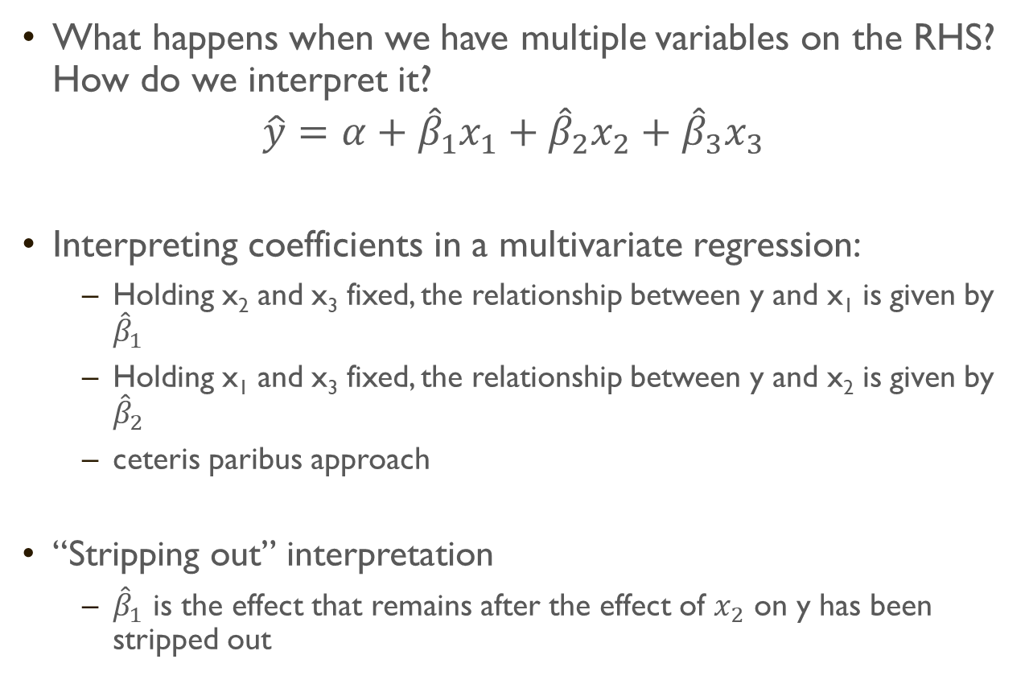
multivariate regressions and categorical variables
What happens when we have multiple variables on the RHS? How do we interpret it?
$$\hat{y}=α+{\hat{β}}_{1}x_{1}+{\hat{β}}_{2}x_{2}+{\hat{β}}_{3}x_{3}$$
Interpreting coefficients in a multivariate regression:
Holding x₂ and x₃ fixed, the relationship between y and x₁ is given by ${\hat{β}}_{1}$
Holding x₁ and x₃ fixed, the relationship between y and x₂ is given by ${\hat{β}}_{2}$
ceteris paribus approach
“Stripping out” interpretation
${\hat{β}}_{1}$ is the effect that remains after the effect of $x_{2}$ on y has been stripped out

Slide 24
multivariate regressions and categorical variables
Categorical variables cannot be explained the same way as numerical variables
E.g. salary = age + age² + gender
If we observe a positive coefficient for age
This means that salary increases the older you are
If we observe a negative coefficient for age²
This means that the salary is increasing at a decreasing rate the older you are
If we encode gender as male = 0, female =1, transgender = 2
And we observe a positive coefficient for gender
We might want to conclude that transgender earns more than female, who earns more than male
This interpretation is wrong because there is no rationale why genders are ranked in an ordinal manner (higher number for age = older, but higher number for gender = ?)

Slide 25
multivariate regressions and categorical variables
As such, categorical variables are interpreted via benchmarking against a base category
The equation actually looks like this:
salary = age + age² + female + transgender
where each observation can only have 1 gender (i.e. if male, then female = 0, transgender= 0)
Where is male=1? Because male can be denoted by female=0 and transgender =0, therefore having another column for male = 1 is redundant
Person ID | salary | age | age x age | female | transgender
1 | 90,000 | 32 | 1024 | 1 | 0
2 | 184,500 | 28 | 784 | 0 | 1
3 | 48,650 | 42 | 1764 | 0 | 0

Slide 26
multivariate regressions and categorical variables
Person ID | salary | age | age x age | female | transgender
1 | 90,000 | 32 | 1024 | 1 | 0
2 | 184,500 | 28 | 784 | 0 | 1
3 | 48,650 | 42 | 1764 | 0 | 0
salary = age + age² + female + transgender
As we denote male as female = 0 and transgender = 0, male becomes the benchmark category
The coefficient for female denotes how much more (or less) salary the female category earns against the male category
The coefficient for transgender denotes how much more (or less) salary the transgender category earns against the male category

Slide 27
Exercise
Go through the codes in “statistical models – linear regression.ipynb” on the seatbelts dataset
Load the titanic dataset and explore the data using the techniques demonstrated
Descriptive statistics
Inspecting, slicing data
Test of variances
Scatterplot
Linear regression (make sure you can interpret numerical and categorical variables)

Slide 28
Statistical model techniques
the logistics regression

Slide 29
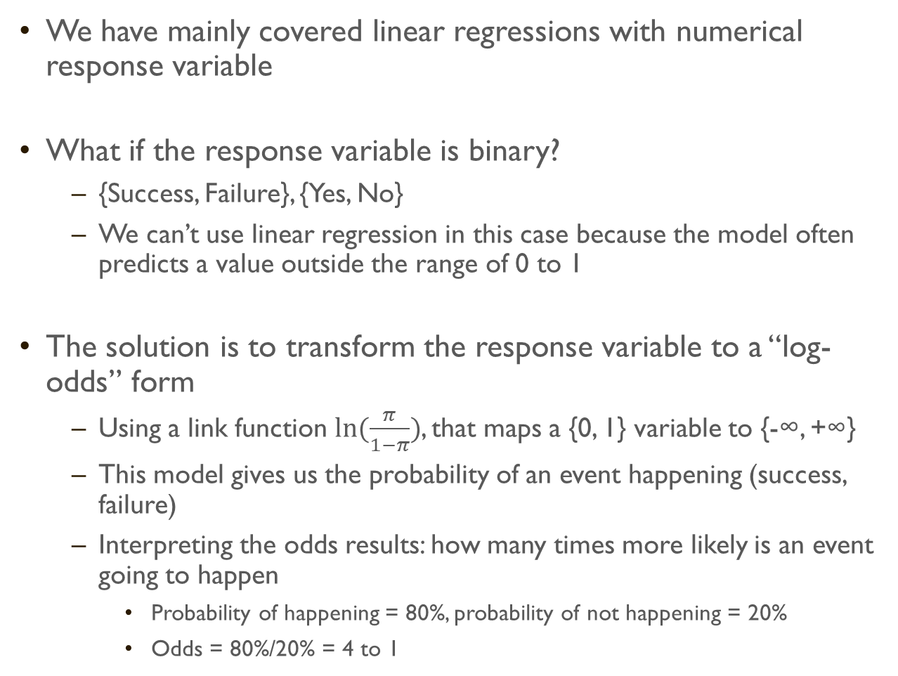
Logistic regression I
We have mainly covered linear regressions with numerical response variable
What if the response variable is binary?
{Success, Failure}, {Yes, No}
We can’t use linear regression in this case because the model often predicts a value outside the range of 0 to 1
The solution is to transform the response variable to a “log-odds” form
Using a link function $ln⁡(\frac{π}{1−π})$, that maps a {0, 1} variable to {-∞, +∞}
This model gives us the probability of an event happening (success, failure)
Interpreting the odds results: how many times more likely is an event going to happen
Probability of happening = 80%, probability of not happening = 20%
Odds = 80%/20% = 4 to 1

Slide 30

Logistic regression II
The 2nd model that is widely used in academia and industry
The logistic regression model is set up as a linear combination of independent variables
Independent variables can be quantitative or categorical (similar to linear regression)
Income
Qualifications
Job Title
Etc…
$$\ln\left(\frac{π}{1−π}\right)=α+β_{1}x_{i}+…+β_{k}x_{k}$$

Slide 31
Exercise
Upload “logistics regression.ipynb” into your dashboard
Follow the comments and codes in the notebook
Note that for predictive projects:
We need to split the data into train and test set
If we used a train models to predict on any observations in the training set, we are going to get very good results (this is in-sample bias)
To get an objective accuracy test, we need to use the trained model on a set of observations that the model has not been trained on
Load the dataset on Weekly S&P Stock Market and see if you can create a logistics model to predict the direction of the stock

Slide 32
Questions?
Email any queries to
jackhong@smu.edu.sg

